Slide 1
Air Pollution

Slide 2
Major Air Pollutants
Nitrogen Oxides
Carbon Oxides
Sulfur Oxides
Particulates
Ozone
PANS
Volatile Organic Compounds (VOCs)
Radon (Indoor air pollutant)

Slide 3
Law – Clean Air Act
1963 - first passage
1970, 1977 and 1990 - amended
Involves EPA
Sets standards for acceptable levels of sulfur oxides, nitrogen oxides, ozone, carbon monoxide, hydrocarbons, lead, & more
Provides pollution credits for industries that utilize pollution-control devices
It established NAAQS and AQI
Clean Air Act: EPA

Slide 4
National Ambient Air Quality Standards (NAAQS)
Sets acceptable concentrations for 6 “criteria” pollutants that:
Threaten public health/the environment over broad areas (non-point)
Are emitted in large quantities
CO, Pb, Nitrogen Oxides, Ozone, Particulate Matter and Sulfur Dioxides

Slide 5
Air Quality Index (AQI)
Measures levels of 5 criteria pollutants
Forecast of daily air pollution levels
Purpose to educate and protect public- focuses on health effects
www.airnow.gov
China's air quality

Slide 6
Primary Pollutants
Pollutants that retain the same chemical formula from the source to the atmosphere
methane, SO2, CO, CO2, NO, dust particles, microorganisms, and chlorofluorocarbons (CFC’s)
Causes of Primary Pollutants – factories, cars, wind and soil, volcanoes, forest fires, pollen, decaying plants, salt particles from the sea, and refrigerants.

Slide 7
Carbon Oxides
Carbon Dioxide
By-product of respiration, burning fossil fuels and forest fires
No human health effects
Environmental effects
Adds to the Greenhouse Layer
Increased oceanic carbon dioxide absorption leads to ocean acidification

Slide 8
Carbon Monoxide
By-product of burning fossil fuels
In your home, gas furnaces are the most direct source of CO
No negative environmental effects
Human Health Effects:
Dizziness
Headaches
Fatigue
Death by suffocation. CO bonds to the red blood cells so they can no longer carry oxygen to the body
Camping

Slide 9
Prevent Carbon Monoxide Poisoning
Get your furnace checked annually
Have working CO alarms in every level of your home
Never use propane heater in an unvented tent
Follow these tips from the CDC:
Carbon Monoxide Poisoning Prevention - CDC

Slide 10
Nitrogen Oxides
Source: Burning fossil fuels
Human Health Effects
Respiratory aggravation
Environmental Effects
Acid rain formation
Adds nitrogen to coastal waters - eutrophication

Slide 11
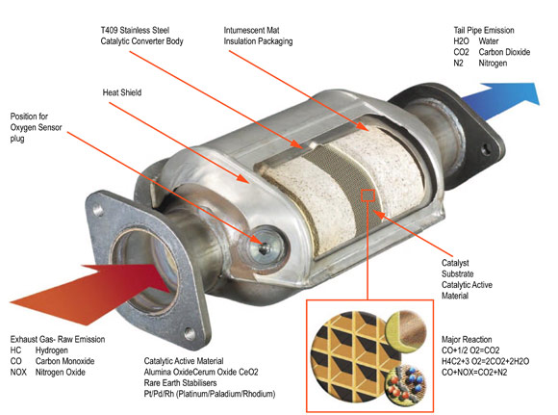
Mitigation
Catalytic Converter
http://mastermuffler.net/catalytic-converter/

Slide 12
Volatile Organic Compounds
Sources:
Paint
Pesticides
Dry cleaning solutions
Household cleaners
aerosols
Human Health Effects:
Eye, nose and throat irritation
headaches, loss of coordination and nausea
damage to liver, kidney and central nervous system
May be carcinogenic

Slide 13
Reducing VOC exposure
Environmental Effects:
VOCs can form tropospheric ozone
How to reduce your exposure:
Use VOC free paints, cleaning solutions and dry cleaners
Follow these guidelines set by the EPA: Reducing VOC exposure

Slide 14
Particulates
Small particles in the air
The smaller the particulate, the more harmful it can be because they can get through our body’s natural defenses
Symptoms:
Eye, ear and throat irritation
Coughing, shortness of breath
Aggravation of heart and respiratory conditions
Some particulates are carcinogenic

Slide 15
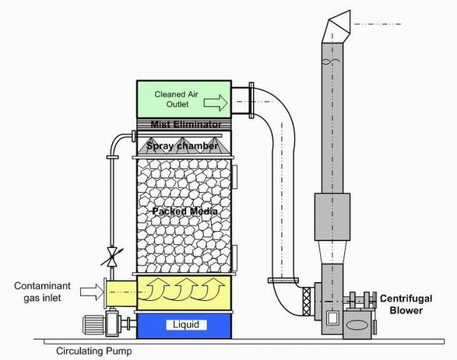
Mitigation Techniques
Wet Scrubbers – removes particulates & Sulfur oxides

Slide 16
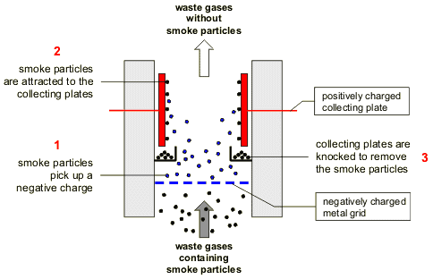
Mitigation Techniques
Electrostatic Precipitators
http://www.bbc.co.uk/schools/gcsebitesize/science/images/ph_elect28.gif

Slide 17
Mitigation Techniques
Mechanical Filters
Air filters like your furnace filter, car filter
Remove particulates from the air. Particulates removes depends on the quality of the filter.

Slide 18
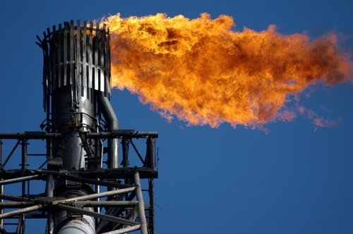
Mitigation Techniques
After-burners – used for VOCs and particlute pollution control
Breaks down the molecular structure into CO2 and Water Vapor
Used often for Methane (CH4)
May be used for energy
http://depts.washington.edu/centc/research_methane.htm

Slide 19
Secondary Pollutants
Formed when primary pollutants undergo a chemical change
Examples: ozone, sulfuric acid, aldehydes, PANS

Slide 20
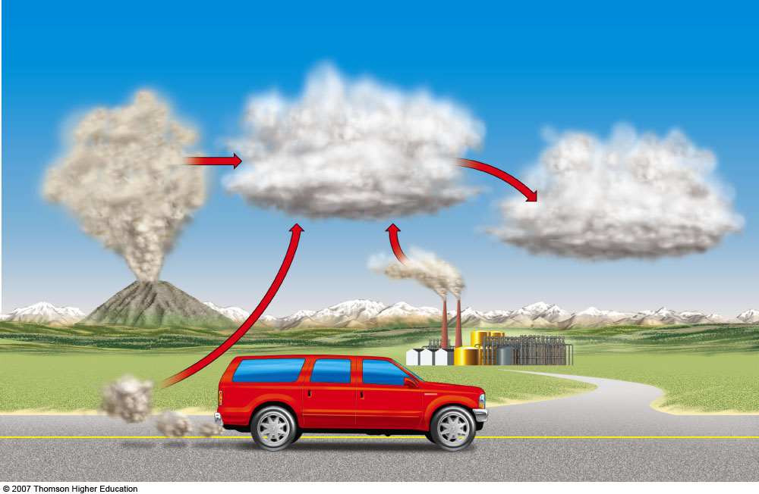
Primary Pollutants
CO
CO₂
Secondary Pollutants
SO₂
NO
NO₂
Most hydrocarbons
SO₃
HNO₃
H₃SO₄
Most suspended particles
H₂O₂
O₃
PANs
Most NO₃– and SO₄^{2–} salts
Sources
Natural
Stationary
Mobile
Fig. 19-3, p. 442
Notes:
Figure 19.3
Natural capital degradation: sources and types of air pollutants. Human inputs of air pollutants may come from mobile sources (such as cars) and stationary sources (such as industrial and power plants). Some primary air pollutants may react with one another or with other chemicals in the air to form secondary air pollutants.

Slide 21
Sunlight plus Cars Equals Photochemical Smog

Slide 22
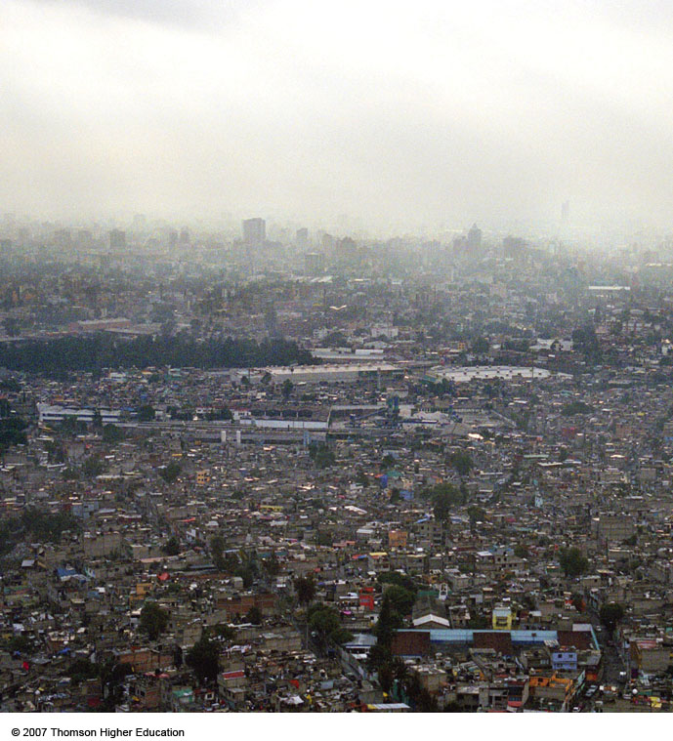
Sunlight plus Cars Equals Photochemical Smog
Mexico City is one of the many cities in sunny, warm, dry climates with many motor vehicles that suffer from photochemical smog.
Figure 19-4

Slide 23
Temperature Inversions
Cold, cloudy weather in a valley surrounded by mountains can trap air pollutants (left).
Areas with sunny climate, light winds, mountains on three sides and an ocean on the other (right) are susceptible to inversions.
Figure 19-5

Slide 24
INDOOR AIR POLLUTION
Indoor air pollution usually is a greater threat to human health than outdoor air pollution.
According to the EPA, the four most dangerous indoor air pollutants in developed countries are:
Tobacco smoke.
Formaldehyde.
Radioactive radon-222 gas.
Very small fine and ultrafine particles.

Slide 25
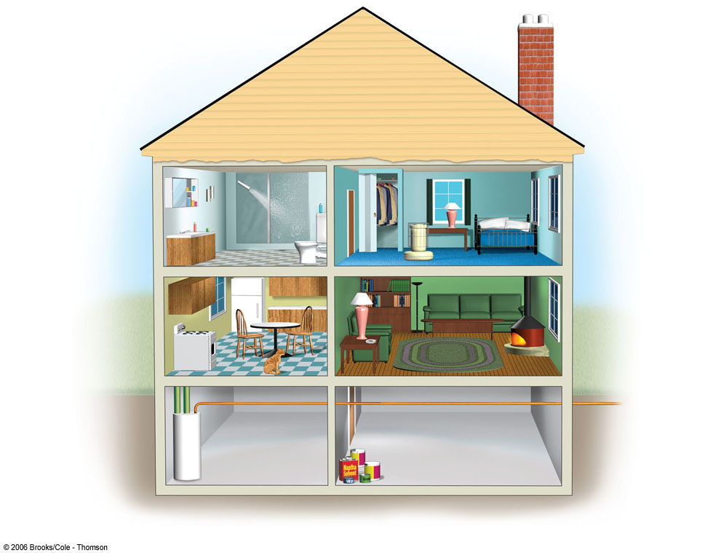
Para-dichlorobenzene
Chloroform
Tetrachloroethylene
Formaldehyde
1, 1, 1-
Trichloroethane
Styrene
Nitrogen Oxides
Benzo-α-pyrene
Particulates
Tobacco Smoke
Radon-222
Asbestos
Carbon Monoxide
Methylene Chloride
Fig. 19-11, p. 453

Slide 26
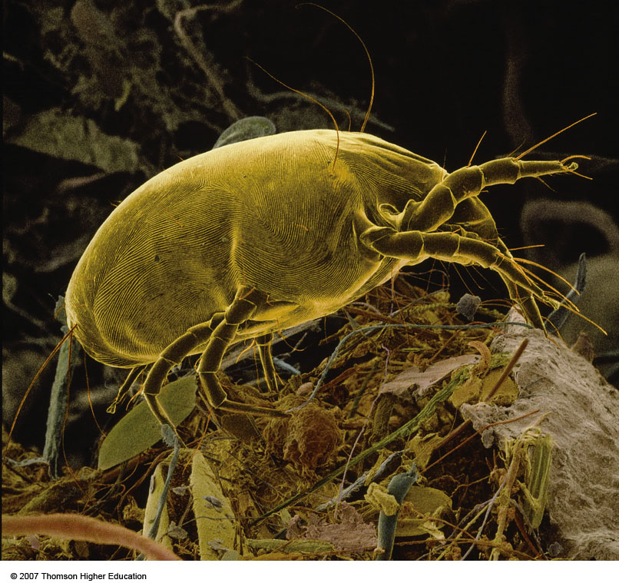
INDOOR AIR POLLUTION
Household dust mites that feed on human skin and dust, live in materials such as bedding and furniture fabrics.
Can cause asthma attacks and allergic reactions in some people.
Figure 19-12

Slide 27
Radon (Rn):
Is a naturally occurring radioactive gas found in some types of soil and rock.
It can seep into homes and buildings sitting above such deposits.
Long-term exposure can lead to radiation induced cancer

Slide 28
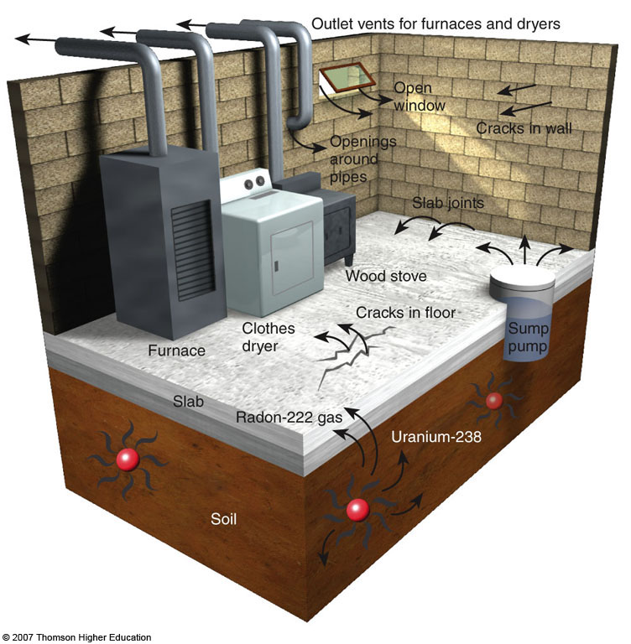
Case Study: Radioactive Radon
Radon-222, a radioactive gas found in some soils and rocks, can seep into some houses and increase the risk of lung cancer.
Sources and paths of entry for indoor radon-222 gas.
Figure 19-13

Slide 29
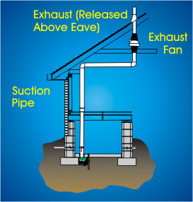
Radon Mitigation
Vent air

Slide 30
OZONE DEPLETION IN THE STRATOSPHERE
Ozone thinning: caused by CFCs and other ozone depleting chemicals (ODCs).
Increased UV radiation reaching the earth’s surface from ozone depletion in the stratosphere
UV radiation DOES NOT increase temperatures, Infrared radiation increases temperatures. Ozone thinning does not directly contribute to global warming.

Slide 31
Sources of ozone depleting chemicals
CFCs = Chloroflorocarbons – aerosols, coolants
Halons - Fire retardants
Hydrogen chloride – rocket launches

Slide 32
Ozone Depletion – the chemistry
Sunlight

Slide 33
Ozone Depletion
ozone destruction animation
Effects of Ozone Depletion
Increased skin cancer
Increased cataracts
Increased sunburn
Decreased phytoplankton populations!!!
Decreased plant photosynthesis

Slide 34
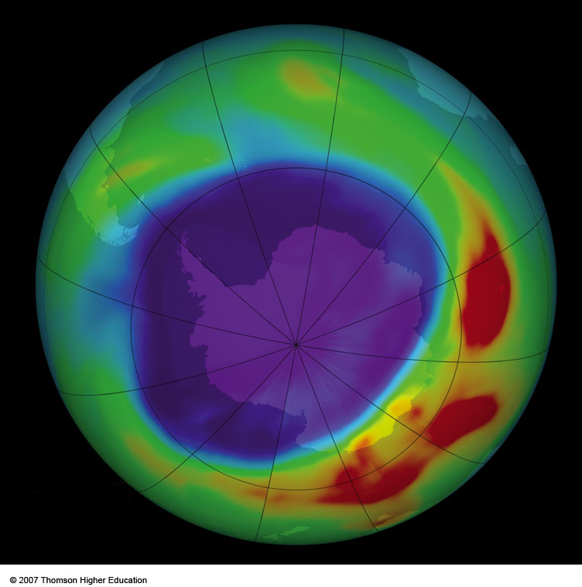
OZONE DEPLETION IN THE STRATOSPHERE
During four months of each year up to half of the ozone in the stratosphere over Antarctica and a smaller amount over the Artic is depleted.
https://www.youtube.com/watch?v=taTzqRHNIEc
Figure 20-19

Slide 35
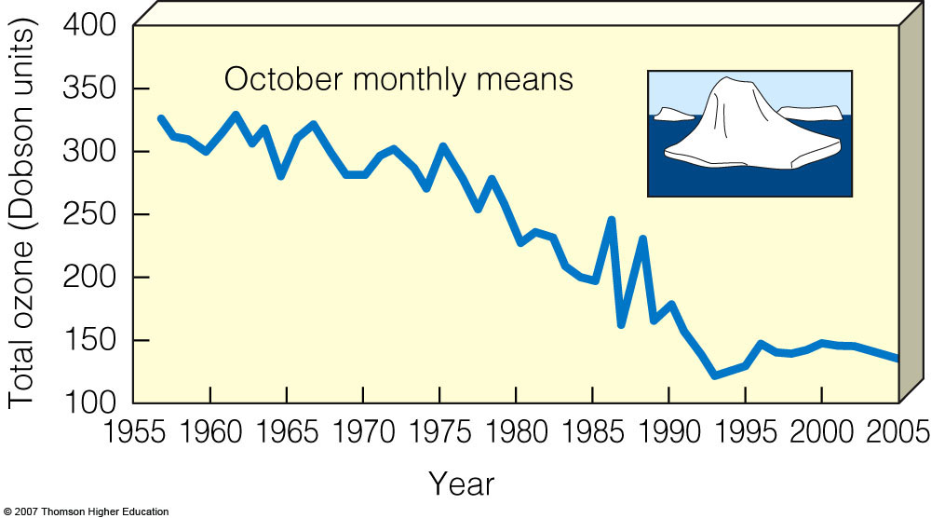
OZONE DEPLETION IN THE STRATOSPHERE
Since 1976, in Antarctica, ozone levels have markedly decreased during October and November.
Figure 20-20

Slide 36
Ozone formation

Slide 37
Montreal Protocol
1987
Limits the amounts of CFCs put into the stratosphere
Voluntary agreement
United States is a part of
Freon 22 banned starting in 2020

