Slide 1
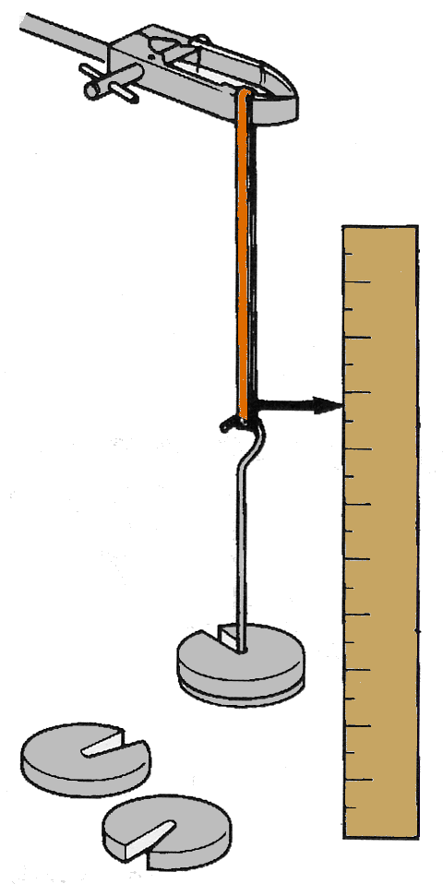
Constant variables
These are all the variables that must not change, to make sure it is a fair test.
Example 1
Investigating how a weight affects the length of an elastic band.
You must use the same elastic band all the time, and the same scale etc, so it is a fair test.

Slide 2
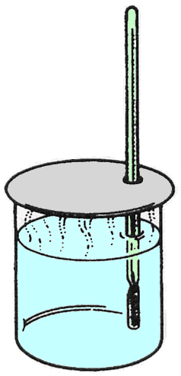
Constant variables
These are all the variables that must not change, to make sure it is a fair test.
Example 2
Investigating how the rate of cooling of a beaker depends on the initial temperature.
You must use the same beaker, with the same amount of water, in the same position in the room, at the same room temperature, so it is a fair test.

Slide 3
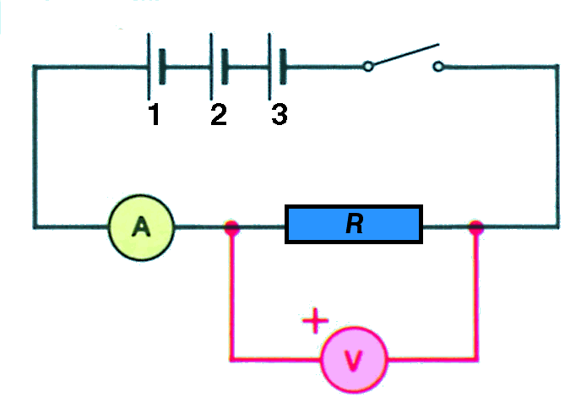
Constant variables
These are all the variables that must not change, to make sure it is a fair test.
Example 3
Investigating how the current through a resistor depends on the voltage across it.
Which are the constant variables here?
Use the same circuit at the same temperature each time.

Slide 4
In Summary
Example 1
The independent variable is ?
weight
The dependent variable is ?
length of the elastic
The constant variables are
same elastic band, same scale, etc, so it is a fair test.

Slide 5
In Summary
Example 2
The independent variable is ?
initial temperature
The dependent variable is ?
temperature as it cools
The constant variables are
the same beaker, with the same amount of water, in the same position in the room, at the same room temperature, so it is a fair test.

Slide 6
In Summary
Example 3
The independent variable is ?
voltage (p.d.)
The dependent variable is ?
current
The constant variables are
the same circuit, at the same temperature each time, so it is a fair test.

Slide 7
Learning Outcomes
You should now:
Understand the difference between - independent, - dependent, and - constant variables
Be able to identify these variables when doing your practical work.

Slide 8
Now let’s look at control variables
This is how you compare what you are testing. It is the “normal” situation to see if your independent variable was the reason for a change.
Examples:
How can you tell if your new shoes will make you faster than your old ones?
How can you tell if a diet you are doing is working?
How can you tell if your new computer works fast?

Slide 9
With Controls!!!
Controls are used to compare your results to.
In other words, they are the NORMAL
There is only one in the experiment
See if you can find it in the following example:
Jamal usually drinks water but is told that he will run the mile faster with Gatorade.
What is the control? (Remember..it’s the normal!
Control: WATER

Slide 10
Try these:
Julia is seeing if her new diet will help her lose weight compared to her normal diet.
John wants to see if the new Corvette is faster than the one he owns.
Samantha wants to test how different colors of light will effect sunlight.
Control:
Normal Diet
John’s corvette
Regular sunlight (white light)

