Slide 1
Ecological Succession
Process through which a new ecological community forms
Primary Succession
Forms where a lifeless
area used to be
Secondary Succession
Forms after a disturbance to
existing organisms
New volcanic island
Retreating glacier
Fire
Disease
Weather
conditions
(Tornado, drought,
windstorm)
Agriculture

Slide 2
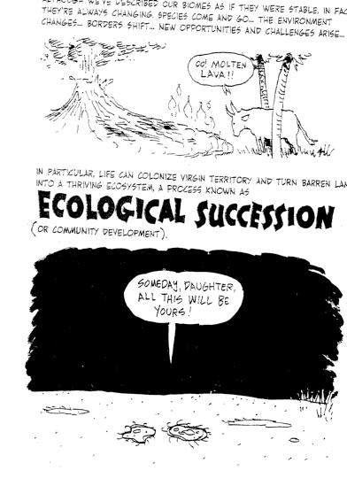

Slide 3
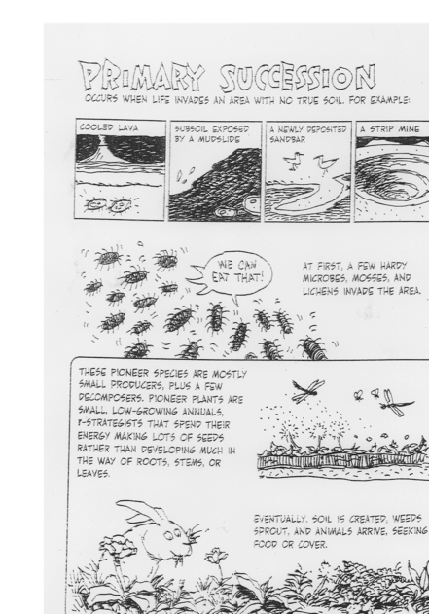

Slide 4
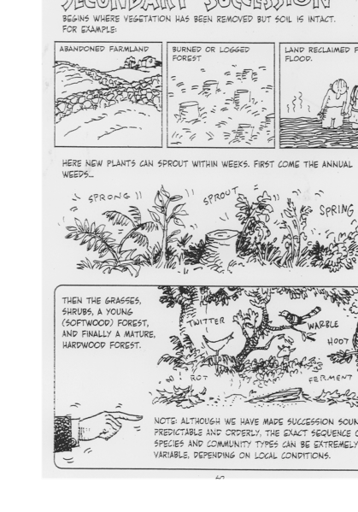

Slide 5
