Slide 1
Water Pollution
Oceans, Rivers, Streams & Lakes

Slide 2
Agriculture
Agriculture is the LEADING cause of water pollution!
Sources of agricultural pollution include:
Eroded sediment
Excess nitrogen and phosphorus from fertilizers
Pesticides
Animal waste
Salt from over-irrigated areas

Slide 3
Industry and Mining
Industrial factories contribute to water pollution by emitting chemicals into the water
Mining creates erosion which releases sediment and toxic chemicals into the water

Slide 4
Causes of Ocean Pollution
80% of marine pollution originates on land
Dumping of untreated waste – largely by developing countries
China’s coastline – large areas along the coastline can no longer support marine ecosystems due to algal blooms
Cruiseliners
Boats
River Pollution

Slide 5
The Rubber Duck Experiment

Slide 7
What we learned:
All oceans are connected
Ocean pollution is a world-wide issue, not a local issue

Slide 8
The Great Pacific Garbage Patch

Slide 9
Case Study:
National Geographic images
Message in the Waves
Proposed Solution

Slide 10
Dead Zones
Aquatic zone with low dissolved oxygen
Few fish and bottom dwellers
Abundant decomposing bacteria
Caused by cultural eutrophication
Cultural Eutrophication – human caused eutrophication (fertilizer runoff, waste from ranches, deposition of nitrogen compounds from the atmosphere)

Slide 11
Oil Pollution in the Ocean
Oil Spills
Exxon Valdez
Gulf Oil Spill
Large oil spills get much publicity, but more oil is spilled into the ocean annually through land runoff from pipeline and refinery leaks than from most accidents
Refined Oil is much harder to clean up than Crude Oil

Slide 12
Oil Spill Clean-up
Crude Oil – marine life usually recovers in about 3 years
Clean-up usually recovers about 15% of spilled oil
Floating booms, skimmer boats, feathers & hair, bacteria
Refined Oil – marine life can take up to 10-20 years to recover

Slide 13
BP Gulf Oil Spill

Slide 14
The Facts
April 20, 2010
An oil rig off of the coast of Louisiana had an explosion which ruptured a pipe resulting in the release of approximately 4 million barrel of oil into the Gulf of Mexico
It took 87 days to stop the spill
11 workers died in the explosion
Deep Horizon Explosion

Slide 15
The area covered

Slide 16
Effects of the spill
Wildlife populations were immediately impacted
Much of the oil is still in the Gulf
Food chains were disrupted
Corals died that were covered in the oil

Slide 17
Why it could have been worse:
The spill occurred in shallow waters
Crude Oil
Warm waters
Rescue teams and funds nearby

Slide 18
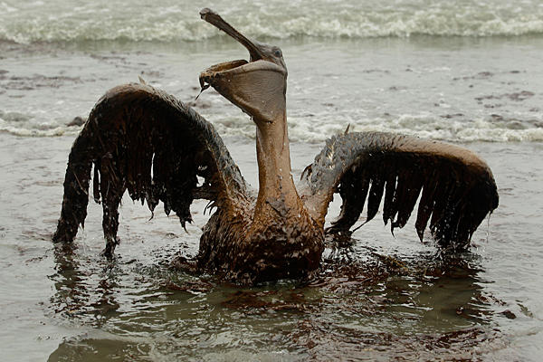
BP Gulf Oil Spill

Slide 19
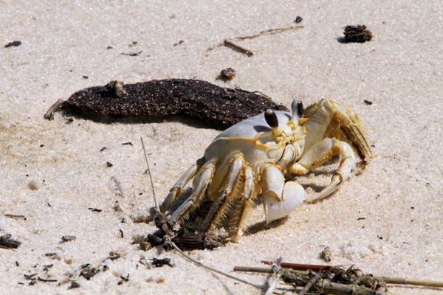

Slide 20
The Exxon Valdez Oil Spill

Slide 21
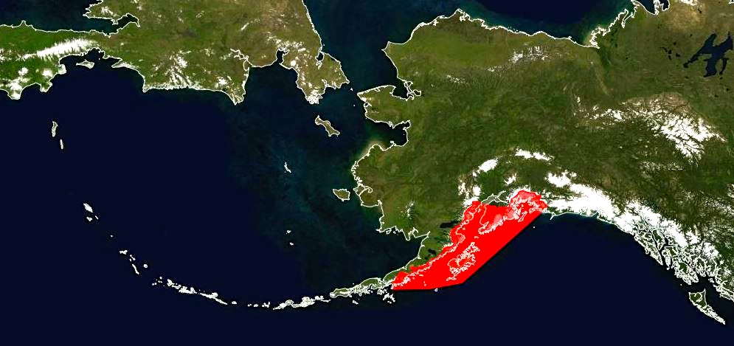
March 24, 1989
The Exxon Valdez cargo tanker struck a reef in Prince William Sound releasing 11 million barrels of oil

Slide 22
Difficulties of clean-up
Remote area - accessible by boat or helicopter only
Extremely cold water = hazardous to rescue workers
High biodiversity – millions of animals died

Slide 23
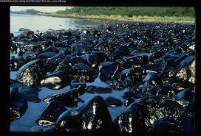

Slide 24
Recovery

Slide 25
What happened to Captain Hazelwood?
Although tests confirmed that Hazelwood was legally drunk per blood tests taken 10 hours after the crash, lawyers argued mis-testing
Captain Hazelwood was fired by Exxon
Final Sentence - $50,000 fine and 1,000 hours of community service

Slide 26
In the aftermath of the Exxon Valdez incident, Congress passed the Oil Pollution Act of 1990, which required the Coast Guard to strengthen its regulations on oil tank vessels and oil tank owners and operators.

Slide 27
River Pollution
According to the WHO, Half of the world’s rivers are polluted!!
Most of these rivers run through developing countries

Slide 28
Cuyahoaga River - Ohio
June 22, 1969
Sparks from a passing train ignited the river
It was so full of oil and other pollutants that the river caught fire
Fires also occurred in 1868, 1883, 1887, 1912, 1922, 1936, 1941, 1948 and 1952

Slide 29
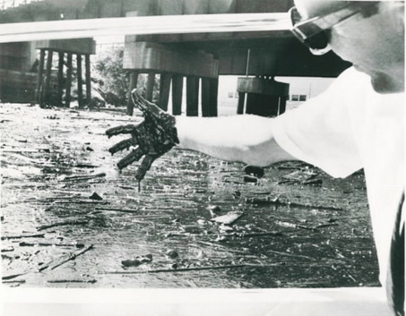
http://www.cleveland.com/science/index.ssf/2009/06/cuyahoga_river_fire_40_years_a.html

Slide 30
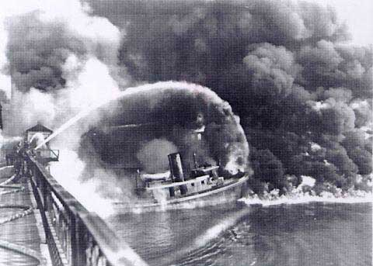
Source: NOAA.gov

Slide 31
Clean Water Act of 1972
Commercial and municipalities must file a permit before dumping waste into water
Establishes pollutant levels
Provides funds to monitor and enforce compliance
Provides restoration and support of aquatic life areas

Slide 32
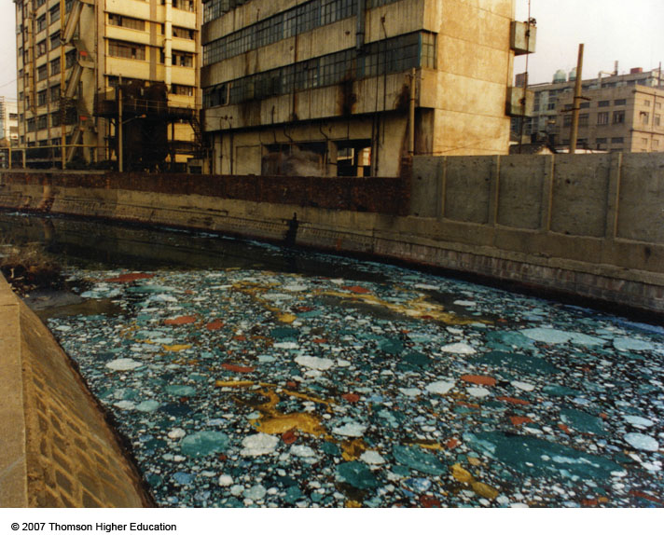
China’s rivers
Figure 21-5

Slide 33
The Ganges River - India

Slide 34
The Ganges River – a river of vital importance
Religious Importance:
Hinduism is the primary religion in India
Hindis believe that to achieve after-life and break the cycle of being reborn on earth, the body must be freed in the Ganges River
Many hindu people pilgrimage to the river to bath in it
Daily use of the river includes bathing, drinking, laundry, swimming

Slide 35
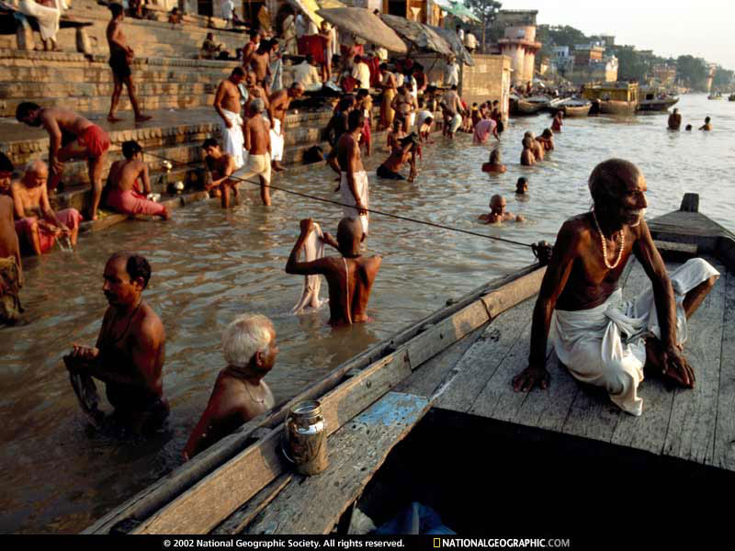
Ganges River
Ganges River Slideshow
Importance of the Ganges to India
http://photography.nationalgeographic.com/photography/enlarge/ganges-bathers_pod_image.html

Slide 36
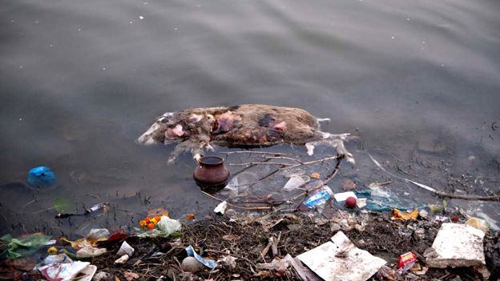
Polluted water
The Ganges is polluted by many things including:
Ganges River Pollution slide show

Slide 37
Groundwater Pollution
Common groundwater pollutants:
Fertilizers
Pesticides
Gasoline
Organic Solvents

Slide 38
Aquifer pollutants
Aquifer Pollution animation
Obstacles to natural clean-up
Low DO levels = low number of decomposing bacteria
Cold temperatures = slower chemical reactions
Result = may take thousands of years for groundwater to cleanse itself of the pollutants!

Slide 39
Can we clean the aquifers?
Solutions
Pump the water to the surface, clean and return – EXPENSIVE!
Inject microorganisms into aquifer
Nanoparticles of inorganic compounds pumped into aquifers (still in development)
A more feasible solution is to purify the drinking water rather than the aquifer itself
Lifesaver Bottle
Lifestraw

Slide 40
Infectious Disease
Infectious Disease can also be spread through the water.
Common infectious diseases:
Typhoid Fever
Cholera
Dysentery
Enteritis
Hepatitis B
Giardia

Slide 41
Water Sanitation
Treatment of water before it is discharged into rivers or oceans
Not all water is treated before being released!

Slide 42
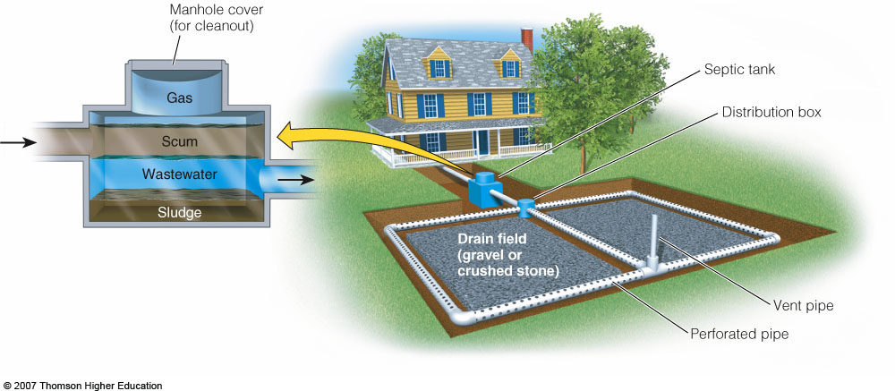
Reducing Water Pollution through Sewage Treatment
Septic tanks and various levels of sewage treatment can reduce point-source water pollution.
Figure 21-15

Slide 43
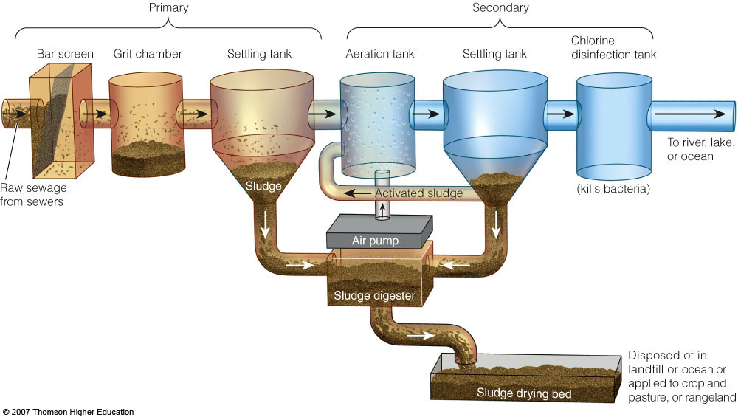
Reducing Water Pollution through Sewage Treatment
Primary and Secondary sewage treatment.
Figure 21-16

Slide 45
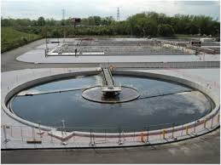

Slide 48
Point vs. Nonpoint sources
Point Source: pollution is discharged from a specific location – drainpipe, ditch, sewer line, factories, oil tankers
Nonpoint Source: pollution is discharged from a broad area – runoff, parking lots, streets

Slide 49
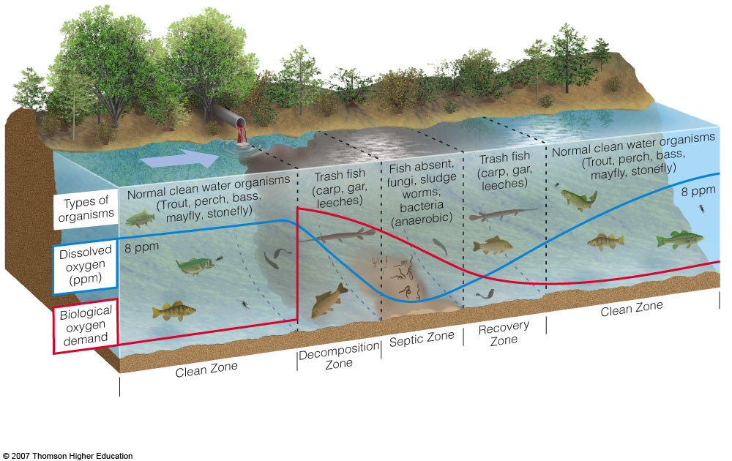
Pollution in Streams and Lakes
Oxygen Sag Curve

